Slide 1



UNIT 2: Home is where heart is
Around the world

Slide 2

Can you name the characters from this unit?
What do you remember about Kira, Harry, Ewan and Pascal?
Write down as much as you can in 2 minutes.

Slide 3
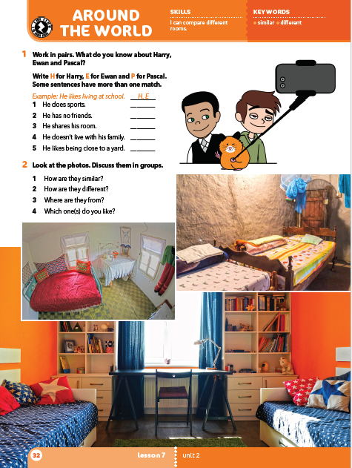
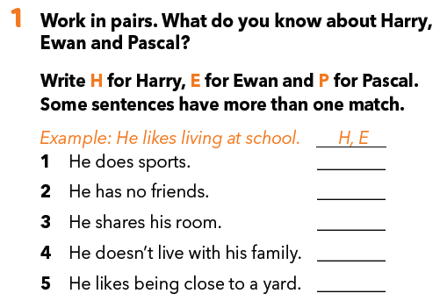
H, E
E, P
H, E
H, P
E

Slide 4
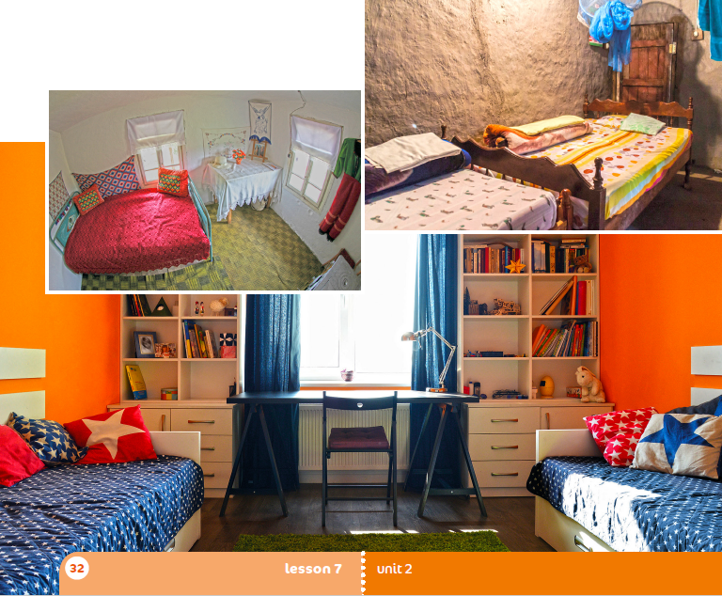
Look at the photos.
Name as many things as you can see.

Slide 5
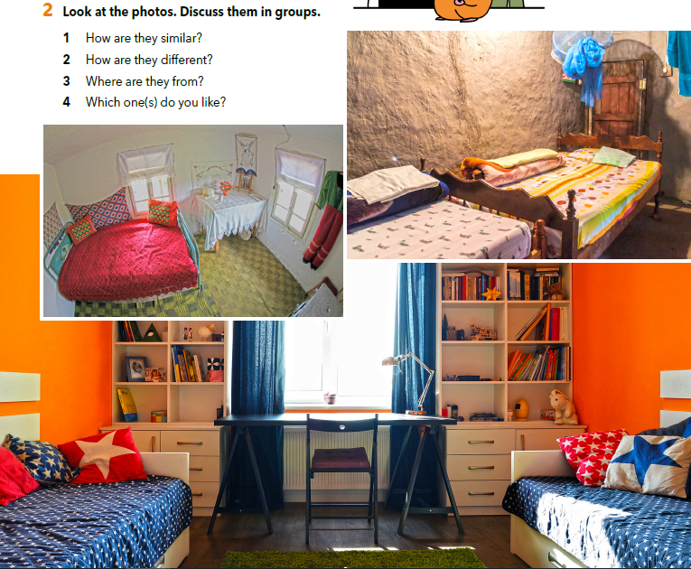
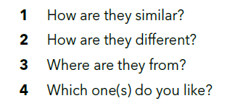

Slide 6
Choose one of the photos and describe it in 5 sentences.
Write the sentences in your notebook.

Slide 7
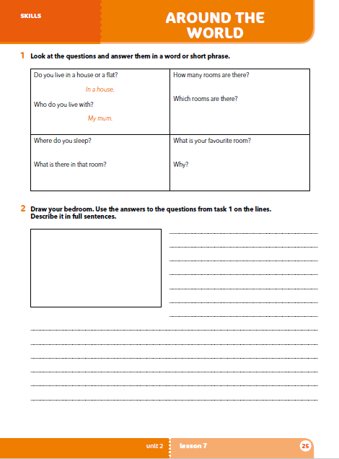
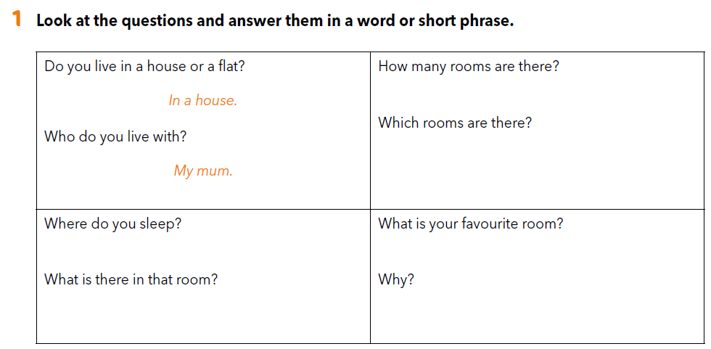
Workbook, page 25.

Slide 8
Describe your bedroom.
If necessary, use the questions and your own answers from task 1.
Ask your friend these questions and then answer the same questions yourself, but this time in full sentences.

Slide 9
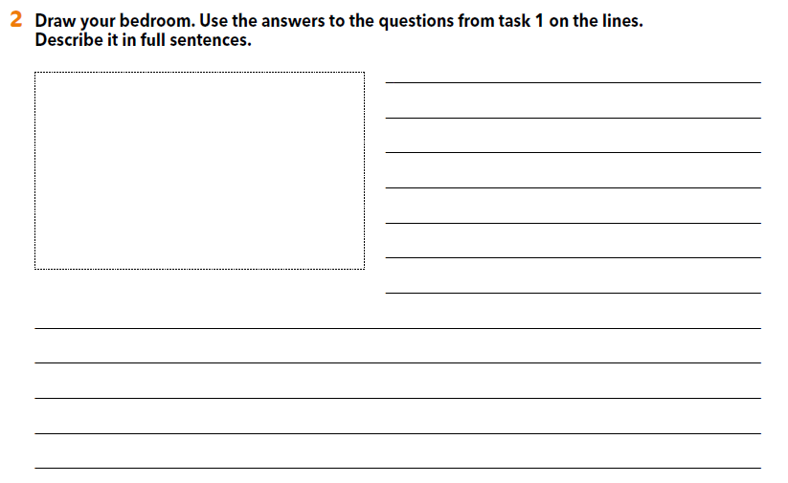
Draw your bedroom.
Use the answers to the questions from task 1.
Write full sentences.
Write the sentences on the lines.

Slide 10

LEARN MORE.
https://www.e-sfera.hr/dodatni-digitalni-sadrzaji/50376956-ceb2-4b6b-99f4-1ddfd4ed8b48/
Houses around the world
Read the texts and answer the questions below.

